Slide 1
Warranty Webinar
Dave Sudweeks
Warranty Administrator

Slide 2
Table of Contents
Terms 3
Flow 4
Missing Parts 5
Freight Damage 6
Coverage 7
Claim Requirements 12
Claim examples 13
Invoices 16
Feedback 17
Back End Processes 18
Tips 20
Frequently Asked Questions 24

Slide 3
Terms
Terms used in this presentation:
  RSM = Auto Crane Regional Sales Manager
  CSR = Auto Crane Customer Service Representative
  Dealer = any company who is able to purchase from Auto Crane
    Only Dealers can submit for warranty reimbursement
    End users who contact Auto Crane for warranty questions will be directed to reach out to their nearest Auto Crane Dealer for warranty service
    Our goal is to drive business to you
  PN = Auto Crane Part Number
  SN = Auto Crane Serial Number

Slide 4
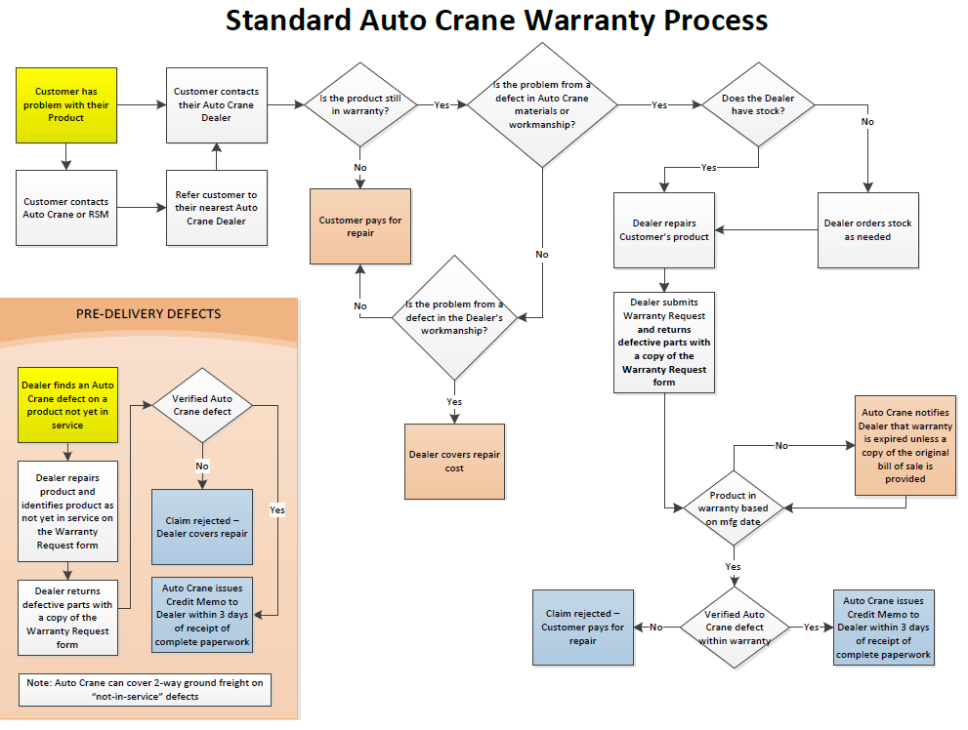
Flow

Slide 5
Missing parts
Missing parts are not covered under warranty
  Warranty covers defective parts and missing parts are not defective – they are missing
  Report missing parts to AC Customer Support by emailing accustomersupport@autocrane.com. Please provide the following information in the email:
    Original PO number
    Part numbers and quantity missing from sales order
  AC Customer Support will initiate a “no charge” new order using the originating PO number with “Shortage” added to the end.

Slide 6
Freight damage
Freight damage is not covered under warranty
  Freight damage must be noted on the bill of lading (BOL) when the product is received and claimed against the carrier
    Failure to note freight damage on the BOL may result in the carrier claiming the damage happened after delivery and denying the claim
  AC Shipping can assist the Dealer in resolving a freight damage claim
    If the Dealer contracted the carrier, the Dealer must file the claim but Auto Crane will assist with the documentation (part costs, etc)
    If Auto Crane contracted the carrier, Auto Crane must file the claim and will need information from the Dealer

Slide 7
Coverage
Covered
Auto Crane workmanship and materials
  Bodies
  Cranes
  Outriggers
  Mounts
Auto Crane branded
  Compressors
Normal customer use and service
Original purchaser only – not transferrable
Covered
Parts purchased from Auto Crane to repair/replace defects
Flat rate labor (at Dealer’s published rate) to make the in-warranty repair
  Dealer must make the repair
1-way ground freight for replacement parts under warranty
2-way ground freight for out-of-box defects (never in service, defective when taken out of the box)

Slide 8
Coverage (continued)
Coverage is per the Auto Crane design
  A difference of opinion or a difference between the Auto Crane design and a perceived “best practice” is not necessarily a defect covered under warranty
  Special requirements must be on the PO and be quoted or the Auto Crane standard is the requirement
    Example: if the customer desires special marker lights but did not specify them on the PO, changing the standard marker lights is not reimbursable under warranty

Slide 9
Coverage (continued)
Not covered
Dealer workmanship and materials
Component accessories
  Vanair
  Miller
  etc
  Customer-specified items
  Customer-provided equipment
Customer/Dealer modifications
Not covered
Aftermarket parts installed in lieu of Auto Crane parts
Damage
Neglect

Slide 10
Coverage (continued)
Not reimbursed
  Travel or transportation
  Loss of use
  Shop supplies (rags, sanding disks, masking tape, etc)
  Maintenance items (fluids, filters, etc)
  Tools needed to make a repair
  Non-defective part replacements
Not reimbursed
  Service fees
  Prep or cleanup time
  Diagnostic or trouble-shooting time
  Document prep or admin fees
  “Minimum” shop time
  Environmental or disposal fees
  “Minimum” charges

Slide 11
Coverage (continued)
Not reimbursed
  Bay time (the time the unit was “in the bay” and no work was being performed) including paint dry time
  Damage (including impacts to the paint from tools, road debris, accidents, etc)
  Damage caused by neglect to perform PM or proper repairs in a timely manner
  Customer or 3rd party labor
Not reimbursed
  Expedite fees or expedite costs (including expedited freight)
  Dealer workmanship (including Dealer mount errors)
  Customer specified or supplied equipment
  “Requirements” that are not on the PO
  Taxes

Slide 12
Claim Requirements
Claim must include:
  PNs and Part cost
  Repair Labor hours
  Repair Labor rate
  1-way ground freight if reimbursement desired
    (can cover 2-way freight on out-of-box defects)
  Description of the defect found and the repair labor performed
    Enough detail that it is clear there is a defect in Auto Crane materials or workmanship
  Proof of in-service (bill of sale) if the product is beyond 2 years from the manufacture date

Slide 13
“Good” claim examples
CS Outrigger leg cylinder bleeds down over time
Cord reel would not retract after extending boom
Transmitter would not power on, even with fresh batteries
Rotation motor was leaking at one of the joints and was replaced
Crane not functioning, diagnosed with AC Tech Support and determined a relay was defective
Door prop assy failed in service

Slide 14
“Problematic” claim examples
Inspected body for warp at wheel well
Bumper tube not painted inside
Crane was received with a bent bail
Hyd hose leaked. Made a replacement in our hose shop
Replaced rotation stop switch assy
Inspection is diagnostic
Standard Auto Crane design – not a defect (unless on PO)
Freight damage - file a freight claim
Aftermarket parts not reimbursed (labor can be)
No description of the defect

Slide 15
Claim Requirements (continued)
Warranty pays at the conclusion of the work:
  Submit when the work is complete
    For no charge parts requests, you must submit the form in advance for the parts and then notify us when the work is complete for the labor credit (see next slide)
The Dealer should remain in the driver’s seat
  Do not let your RSM or the customer offer to handle this for you.
There is currently a hold process for some claims
  If you have not received a credit within 3 business days of filing the claim, you should check with your RSM as the claim is likely awaiting their approval

Slide 16
Claim Requirements (continued)
No charge parts:
  The Auto Crane warranty policy is built around dealers carrying service stock
  If a dealer desires no charge parts under warranty:
    Submit the warranty request in advance of the repair and clearly indicate that no charge parts are requested IN ADDITION to the defect description
    Clearly indicate the ship-to address
  No charge warranty orders are standard orders with standard lead time and standard ground freight, shipped no charge
  If the Dealer needs expedited parts due to not holding service stock, they should order with a PO and submit for reimbursement
    Expedited freight and expedite fees are not reimbursed under warranty

Slide 17
Claim Requirements (continued)
Part return:
  Unless pre-approved by warranty, defective part return is always required
    Except for out-of-box defects, the customer is responsible for return freight cost
  Issuance of the credit in advance of the part return is at the direction of our CEO to assist our Dealers in their financial processes – it does NOT mean “scrap the part”
  If there is a question (i.e. low cost parts), contact warranty – we will not ask you to return something we will just scrap here

Slide 18
Invoices
Per the Auto Crane warranty policy:
  “No claim will be allowed unless [the Auto Crane Warranty Request Form] has been properly executed and approved by Auto Crane”
    Invoices for warranty work will not be considered or responded to – only the Auto Crane Warranty Request form will receive warranty consideration

Slide 19
Feedback
The current version of the Warranty Request form (Rev 4) is available by logging into the Dealer Portal at AutoCrane.us
Use this form and include their email address as indicated
  Please write legibly or type the email address
  The Rev 4 Warranty Request is a fillable form so can be done electronically.
Auto Crane will provide feedback via email once the claim has been processed. Feedback includes:
  Findings
  Warranty Amounts approved by Category (Labor, Freight, etc.)
  Credit Memo #
  Auto Crane Team Member processing the claim
  Date claim was processed
Contact your RSM if you need assistance in accessing the Dealer Portal

Slide 20
Back End Processes
Warranty data is extensively used for quality improvement meetings, quarterly management reviews, etc.
  Every returned defective part generates a supplier rejection that supply uses to manage the supply base and drive improvement in their products
Warranty decisions on provided information represent a full reimbursement per the terms of the Auto Crane warranty policy based on the information submitted by the Dealer
  If additional information becomes available from what was originally submitted, it can be considered
Less than a full reimbursement is usually caused by:
  Non-warranty items listed as warranty (diagnostic, damage, modifications, expedite fees, shop supplies, etc)
  Warranty labor listed beyond reasonable amounts
    “Flat rates” are 1.5-2 times the amount of labor we would take to do the same work
  Unclear, vague, or confusing description on the Warranty Request form

Slide 21
Back End Processes (continued)
All Dealers are expected to perform warranty work on any Auto Crane product, regardless of who originally sold the unit
  Auto Crane does not require Dealers to perform warranty work “at no charge” in advance of issuance of the warranty reimbursement

Slide 22
Tips
Keep it simple
  Crane warranty for crane items, body warranty for body items, etc
  Auto Crane Mount defects should be filed under the Body SN
  Outriggers now have their own SN and should be claimed as a separate product (if no SN on the outrigger, use the body SN)
  Multiple products are allowed on a single claim but ALL SNs must be provided
    Recommend separate claims for different problems on different products to avoid confusion

Slide 23
Tips (continued)
Keep it clear
  Auto Crane warranty representative is not at your facility and has no access to Tech Support or Engineering notes
    The information provided with the Warranty Request form must be detailed enough and clear enough to describe the defect
    Don’t waste paper explaining how important the customer is – they are all important
    Don’t waste paper explaining how difficult the problem is – stick with the facts
      What was the defect?
      What was done to correct the defect?
      What were the labor hours to correct the defect?
      What was the Dealer part cost for the Auto Crane parts to correct the defect
    If your published labor rate changes, you need to provide a new copy

Slide 24
Frequently asked questions
Q: How are flat rate repair times determined?
A: Decades of history accumulated
  When new defects/repair requests come in – we review with operations and assess the reasonable repair labor
  We add 50-100% buffer to the labor hrs we as a OEM would take to do the repair
  When design changes occur that impact time we adjust the flat rates as noted above
Q: Will you tell me how many hours a repair should take?
A: Yes, the Auto Crane Warranty Administrator or your Regional Sales Manager can look up a specific repair and provide the Flat Rate repair hrs from our history.

Slide 25
Questions or comments?

